Slide 1
SUJIN SONG
WMM 630
Personal Branding

Slide 2
The Five Values of Design Services
-Creativity: creative thinking and able to develop new ideas and previous designs to different viewpoint, innovative ideas for projects all the times.
-Vision: have sense of vision and have belief of my design and should grasp what my client is looking for.
-Communication: have great communication skills. Should be a good listener and a good advisor for clients.
-Great leaner: the technology, design trends and programs are changeling, but I am a fast learner and able to learn various work at a speedy time.
-Manage Time: time is most important factor with everything. Managing the time skills are crucial factor for the designer and the client.

Slide 3
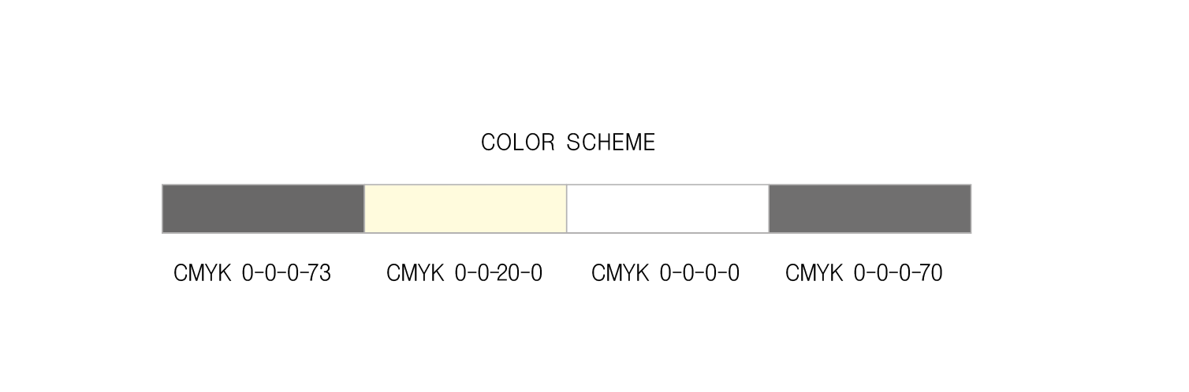
Idea Board
Communication
Creative, Joy
Learner
Vision

Slide 4
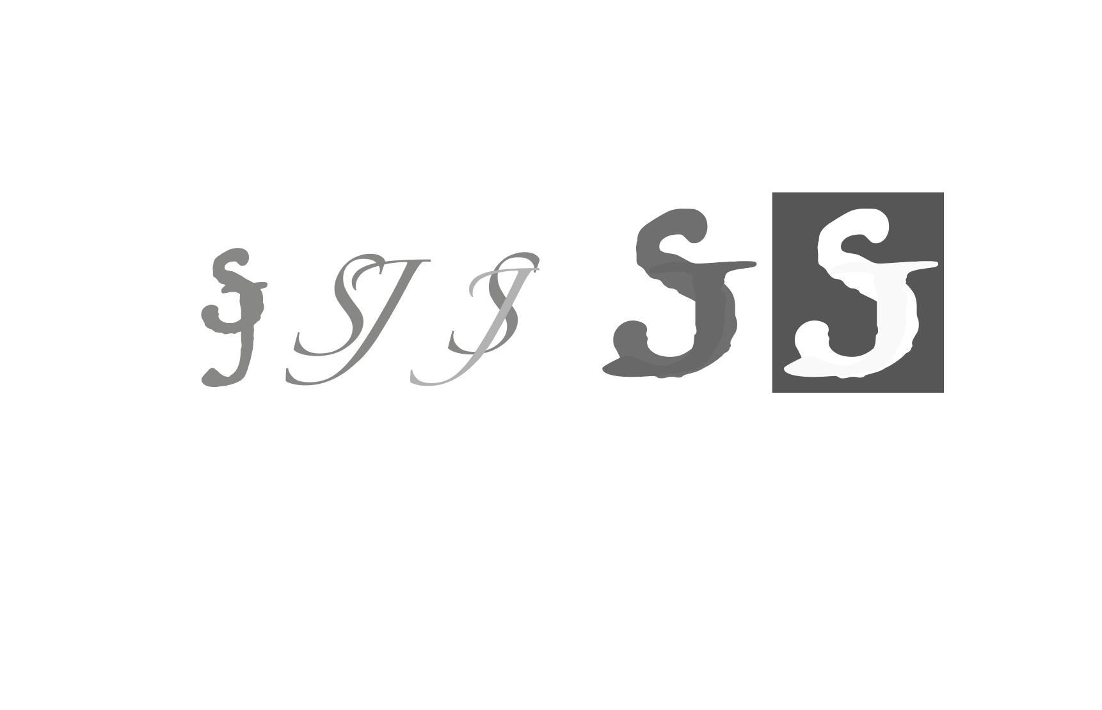
LOGO
Font : Trattatello

Slide 5



Business Card & Envelope

Slide 6
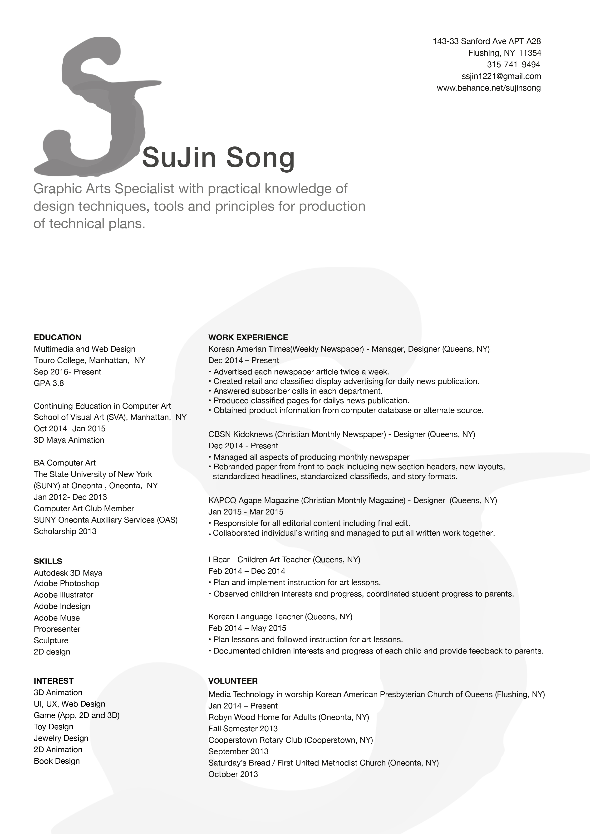
RESUME

Slide 7
